Slide 1
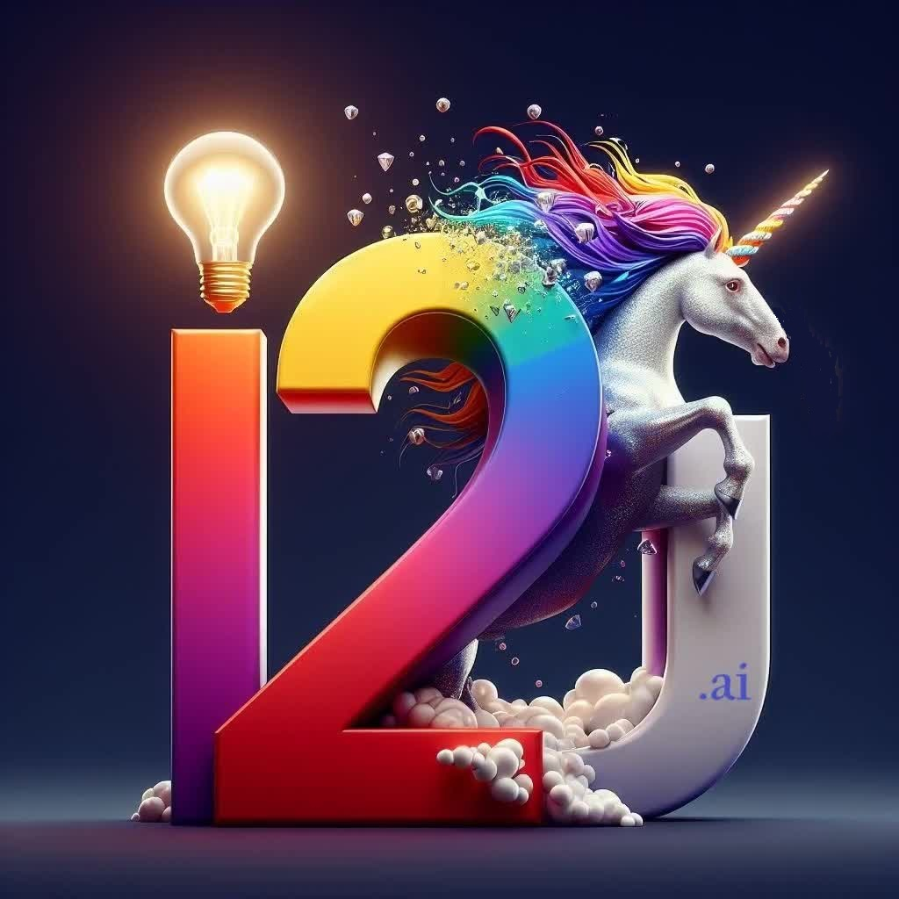

i2u.ai
Ideas to Unicorns through AI!
Business‑Native Agentic AI OS for First‑time Founders, across Sectors & across the Globe
Notes:
Dual Tier-1 VC Validation: We secured rapid responses in just 9 and 11 days from two separate global top tier VC firms' senior partners—unprecedented at our pre-revenue stage. Their individual portfolios include: WhatsApp, Instagram, YouTube, Airbnb, DoorDash, Stripe, Zoom and Facebook, LinkedIn, Workday, AppDynamics, Dropbox, respectively. Collective portfolio power: Palo Alto Networks, Figma, Abnormal Security, GitHub, Pinterest, Snap, Twilio, Canva—representing hundreds of billions in market value.
Ever dream of turning your idea into a billion-dollar success? At i2u.ai, we make it possible! We're the AI-powered ecosystem that transforms ideas into unicorns. Leverage the power of Artificial Intelligence to boost the startups' performance and join the ranks of the most successful unicorns! Are you ready to make your idea legendary? Hear on!

Slide 2

ABOUT US
We are Building the First
Global Agentic AI Startup Ecosystem Booster through i2u.ai Social MarketSpace!
The work on Unicorn Foundational Model (UFM) also has begun!
i2u.ai Inc., a Delaware C Corporation bearing EIN: 36 - 5143244
Notes:
Imagine a world where the startup founders' idea has the ultimate support system. We're building that reality. Introducing the future of innovation: an AI-powered global ecosystem designed to supercharge your startup journey. Think cutting-edge resources, targeted connections, and powerful AI guidance – all at your fingertips. Get ready to take your dream from concept to unicorn. This is the future of startups. This is i2u.ai.

Slide 3
PROBLEM
Customers
Market Gap
> 90% of Startup Ecosystem Stakeholders benefit from extensive infrastructure, which we will complement & boost
Very few, if any, online Startup Enablers in the market to help all the Startup Ecosystem Stakeholders
Costs
Financials
Loss of productivity & effectiveness costing global startup ecosystem billions of dollars
Most of 100 Million+ startups & MSMEs grow exponentially! The spend by them to achieve growth & get funding exceeds $100Bn., annually.
Notes:
Let's talk about the current startup landscape. While some stakeholders have access to extensive resources, there's a critical gap for many. Fewer than ever have the online support they need to truly thrive. This translates to lost productivity and billions of dollars in wasted potential across the global ecosystem.
But here's the exciting part: history shows that successful startups often experience explosive growth. The annual spending just to achieve that growth and secure funding reaches over $100 billion! That's a massive opportunity waiting to be optimized.

Slide 4
WHY NOW?
Well, Why Not Now?
We are right in the middle of multiple technologies converging leading to the emergence of Artificial Intelligence.
Optimum Application of AI
We have developed the infrastructure & resources to educate, train, coach, handhold and ultimately lead & boost the startups to leverage the converging & emerging divergent technologies. In addition, we enhanced it with the latest developments in AI
Notes:
The timing for this couldn't be better. We're witnessing a convergence of powerful technologies, paving the way for a new era of AI. But here's the challenge: the infrastructure and resources just aren't there to fully equip startups to harness this potential. We're bombarded with AI advancements, yet many lack the guidance to truly leverage them. This is where i2u.ai steps in. We'll bridge the gap, empowering startups to capitalize on this incredible moment in innovation.

Slide 5




SOLUTION
Close the Gap
Target Audience
Cost Savings
Exponential Growth
i2u.ai, ideas to unicorns through AI, brings all the startup ecosystem stakeholders together in highly effective & engaging way boosting even the best platforms, globally.
Global Startup Ecosystem stakeholders,- startups, mentors, investors, consultants, coaches, talent, incubators, accelerators, …
Reduce expenses by collaborating & complementing stakeholders in any corner of the world effectively & efficiently thus optimally!
With access to the best minds in the world in highly engaging & effective manner, achieve phenomenally exponential growth to achieve unicorn status!
Notes:
Imagine a global network where every startup stakeholder thrives. i2u.ai connects startups, mentors, investors, incubators, accelerators ... and more! A powerful ecosystem fueled by AI. We don't compete with existing platforms, we collaborate with them, we complement them and boost the the whole Startup ecosystem all over the world! This means reduced expenses, efficient collaboration, and access to the best minds worldwide. The result? Exponential growth for your startup, propelling you towards that coveted unicorn status. This is the future of collaboration. This is i2u.ai.

Slide 6



PLATFORM OVERVIEW
Unique
Best to Market
Only platform specifically imagined & built ground up leveraging AI!
Inspired by the best platforms all over the world, both offline & online … and envisioned leveraging AI!
Born Out of Collaboration
Authentic
Built over decades of experience & collaboration with all the stakeholders in the startup ecosystem.
Designed with the help and input of experts in the field ​
Notes:
We're introducing a revolutionary platform unlike any other: i2u.ai. It's the first built from the ground up to leverage the power of AI specifically for the startup ecosystem. We haven't just copied existing models; we've taken inspiration from the best online and offline platforms globally, and infused them with cutting-edge AI capabilities. Decades of experience and collaboration with all corners of the startup world inform our design. Experts have provided invaluable input, ensuring an authentic and effective solution tailored to your needs. This is the future of startup success. This is i2u.ai.

Slide 7
Leveraging AI for Optimized Unicorn Building
7 Years Lead & a >9x Productivity Advantage for AI Startups to Reach Unicorn Status
AI Ventures: ~406 Man-years (2 Years × 203 Employees)
Non-AI Ventures: ~3,726 Man-years (9 Years × 414 Employees)
Source: CB Insights
9 Phases with Dynamic 9 Dimensions & 9 EiR Aspects Each
Known Knowns Established Patterns in Successful AI Ventures › Proven Business Models › Optimal Team Compositions › Effective Go-To-Market Strategies | Known Unknowns Identified Challenges Requiring Research › Emerging Market Opportunities › Regulatory Landscape Evolution › Technology Stack Scalability
Unknown Knowns Tacit Knowledge Awaiting Discovery › Untapped Organizational Insights › Hidden Market Signals › Underutilized Industry Expertise | Unknown Unknowns Breakthrough Opportunities & Risks › Disruptive Innovation Potential › Unforeseen Market Shifts › Emerging Competitive Threats
Notes:
There is incredible acceleration of AI unicorns and our approach to building them.
AI startups are reaching unicorn status faster than ever, driven by automation, exponential data leverage, global scalability from day one, strong investor interest, and the rapid 10x annual progress in AI itself. They achieve this with significantly smaller teams and in a fraction of the time compared to traditional companies – demonstrating a massive efficiency multiplier.
To navigate this, we use a dynamic knowledge framework. It's built on a 2x2 matrix categorizing what we know and don't know: Known Knowns, Known Unknowns, Unknown Knowns, and the crucial Unknown Unknowns. This framework guides ventures through 7 development stages and dimensions, continuously optimized by our AI based on real-world data.
Our goal? To potentially achieve a 9.2x efficiency improvement in building unicorns, transforming innovative ideas into market leaders by leveraging AI insights at every step..
According to industry analysts, several factors explain why AI unicorns are growing faster than ever:
Scalability Through Automation: AI startups build products around automation, eliminating the need for large teams to perform repetitive tasks
Exponential Data Leverage: AI models improve over time, enabling better results with minimal additional investment
Global Market Fit from Day One: AI solutions are inherently scalable globally with minimal additional infrastructure
Strong Investor Interest: The AI boom has attracted significant capital, accelerating growth and enabling faster scaling
AI Progress: As you noted, AI capabilities themselves are advancing at approximately 10x per year, creating compounding effects for startups in this space
Regional AI Unicorn Distribution
The United States dominated AI funding (76%) and deals (49%) in 2024, with Europe and Asia following. Notable is the median team size at AI unicorns being significantly smaller across all regions.
Commercial Maturity: A Key Difference
Interestingly, CB Insights notes that AI unicorns generally have lower Commercial Maturity scores than non-AI unicorns. This suggests that while AI startups reach unicorn status faster and with smaller teams, their valuations are based more on potential than proven business models at this stage CB Insights.
Conclusion: The AI Efficiency Multiplier Continues to Grow
The transformation of AI startups into unicorns has accelerated even further since last year. The efficiency gap between AI and traditional SaaS companies has widened, with AI startups now reaching unicorn status with:
Half the team size (203 vs. 414 employees)
A quarter of the time (2 years vs. 9 years)
Less than 1/9th the total human resource investment (406 vs. 3,726 Man-Years)
This dramatic efficiency, combined with the rapid pace of AI innovation itself (10x per year as you noted), suggests we're witnessing a fundamental shift in how technology companies scale and create value. The AI unicorn formula - smaller teams, faster scaling, and strong investor backing - continues to redefine what's possible in the startup ecosystem.
At the center of our approach is a knowledge framework that categorizes what we know and don't know about building successful AI ventures.
The 2x2 matrix represents four critical domains:
Known Knowns: These are established patterns we've identified in successful AI unicorns - the proven strategies and approaches that consistently drive results.
Known Unknowns: These are the challenges we've identified but require more research and testing - areas where we're actively developing solutions.
Unknown Knowns: This represents tacit knowledge that exists in the ecosystem but hasn't been formally captured - insights our AI systems can discover through pattern recognition.
Unknown Unknowns: Perhaps most exciting, these are breakthrough opportunities and unexpected risks our systems help identify before they become obvious to the market.
Our framework applies this knowledge matrix through a comprehensive structure:
7 Stages of Unicorn Development, from idea validation to market dominance
7 Dimensions in each stage, covering everything from product development to financial management
7 EiR Aspects per dimension, providing granular guidance at every step
What makes our approach unique is that this isn't static - our AI systems continuously optimize this framework based on real-world results and emerging patterns. This creates a flywheel effect where each successful unicorn journey feeds back into the system, making it more effective for future startups.
In practical terms, this means our platform can identify patterns across successful unicorns, flag potential roadblocks before they emerge, continuously refine strategies based on market feedback, and optimize resources at every development stage.
The result is the potential for a 9.2x efficiency improvement in the unicorn building process - aligning perfectly with the acceleration we're seeing in the broader AI landscape. This is how we're transforming ideas into unicorns through AI.

Slide 8
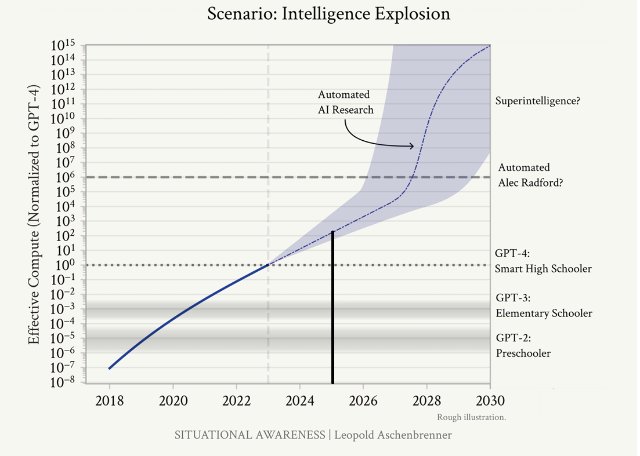
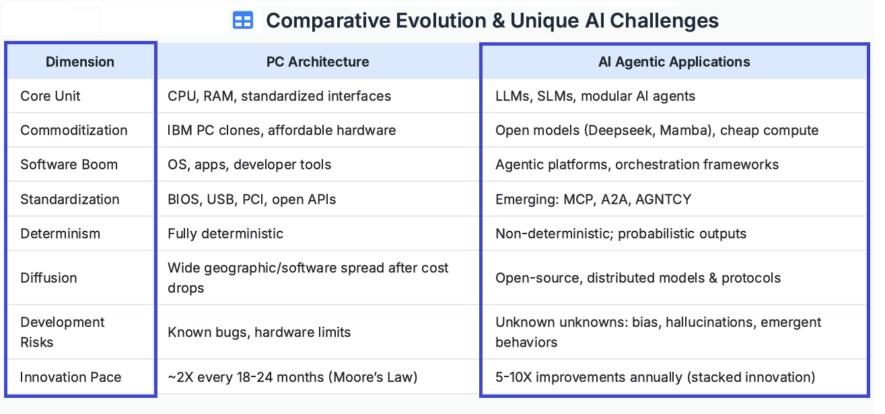
INTELLIGENCE EXPLOSION & GPT DIFFUSION
Leveraging Intelligence Explosion
AI - General Purpose Technology (GPT)
Economic Impact: Unprecedented Industrial Mobilization ($10B → $100B → $1T+ Compute Clusters)
Strategic Advantage: Most Remain Blind While A Small Group Sees the True Trajectory
Opportunity: Forefront of the AI Transformation Wave
Jeffrey Ding’s GPT Diffusion Theory: Innovation Isn’t Enough; Need Widespread Adoption
PC Era Lesson: Technology Impact Depends on Effective Diffusion Mechanisms
AI Challenge: Bridge AI Breakthroughs & Market Adoption
Experience & Expertise for Agile Adoption
Decades of Experience in Market Adoption of Operation Critical Application SW
Deep Startup Ecosystem Engagement Since Dotcom Era
Intense Intent to Grow Ideas into Unicorns
Sources: https://situational-awareness.ai/ & https://www.youtube.com/watch?v=VhDm347BU-U
Notes:
Leopold Aschenbrenner’s Intelligence Explosion graph shows exponential growth in AI capabilities, far outpacing Moore's Law seen in the PC era.
Comparing AI to PC evolution, we see AI is faster, less predictable, and brings unique challenges like bias and hallucinations, alongside 5-10x annual improvements.
Leveraging this means recognizing the unprecedented economic impact – potentially trillions in compute investment – and the strategic advantage for early movers.
As per Jeffrey Ding, AI is a General Purpose Technology, like the PC or internet. Its impact depends on widespread adoption, bridging breakthroughs with real-world use.
Successfully navigating this requires deep experience in market adoption, startup ecosystems, and a drive to grow innovative ideas.
In short, we're in a transformative wave. Understanding the speed, the parallels, the challenges, and the need for effective adoption is key and we have the unique capabilities to succeed!

Slide 9
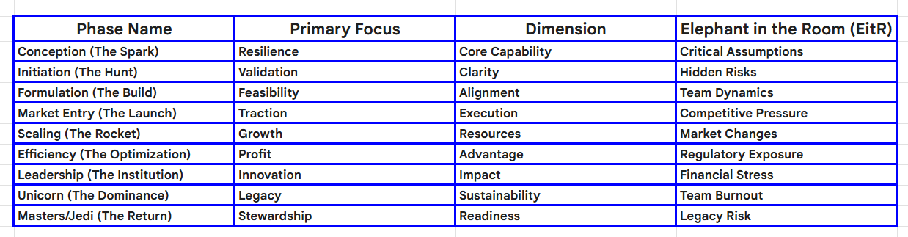
9 Phases with 9 Dimensions & 9 Elephants in the Room (EitRs)

Slide 10



BUSINESS MODEL
Research​
Abstract​
Design​
We based our research on technological advancements, market trends, AI Tools and social media​
We believe people need such platforms more than ever now, specifically dedicated to startups & MSME niche market​
Highly engaging and easy to use ​
Notes:
Data Driven Business Model: We didn't just guess at what startups need. i2u.ai is built on extensive research into cutting-edge technology, market trends, powerful AI tools, and the ever-evolving landscape of social media. The result? A platform designed to meet the critical needs of today's startup ecosystem. We believe this dedicated niche platform is more essential than ever, and we've made it highly engaging and incredibly easy to use. Get ready to experience the future of startup success – i2u.ai.

Slide 11
MARKET OPPORTUNITY OVERVIEW
$10B
$5B
$2B
Opportunity to build​
Fully inclusive market​
Total Addressable Market​ (TAM)
Freedom to invent​
Selectively inclusive market​
Serviceable Available Market​ (SAM)
Few competitors​
Specifically targeted market​
Serviceable Obtainable Market​ (SOM)
Notes:
The startup ecosystem is a massive opportunity waiting to be unlocked. We're looking at a potential market size of $10 billion – a fully inclusive market ripe for disruption. But we can refine our focus even further. Imagine a $5 billion market where we have the freedom to invent, attracting a select group of highly engaged users. Or, we can target a $2 billion market with minimal competition, focusing on the specific needs of a dedicated group. No matter the approach, i2u.ai is poised to become a leader in the future of startup success.

Slide 12
GROWTH STRATEGY
This is how we’ll scale up!
JUL 2024
JAN 2025
JAN 2026
Rolled out product to high profile or top-level participants to help establish the platform​
Released the pivoted product globally on social media with virality & engagement strongly entrenched
Gathering feedback and pivoting portal continuously and discovering & inventing new revenue streams to boost the performance of the Global Startup Ecosystem​ effectively & optimally!
Notes:
We're committed to scaling i2u.ai strategically. This July, we'll launch with a targeted rollout to high-profile players in the startup ecosystem, building a strong foundation. August marks our global release, leveraging social media to ignite viral growth and deep user engagement. But our journey doesn't stop there. Throughout September, we'll continuously gather feedback and refine the platform, ensuring it remains the ultimate performance booster for the global startup ecosystem. Join us as we rewrite the future of success – join us at i2u.ai.

Slide 13
Profits All the Way!
Key Metrics
FY | SUBSCRIBERS | GROSS REVENUE | EXPENDITURE | PROFITS
2026 | 50,000 | $ 5,000,000 | $ 1,400,000 | $ 3,600,000
2027 | 100,000 | $ 10,000,000 | $ 2,485,000 | $ 7,515,000
2028 | 150,000 | $ 15,000,000 | $ 3,825,000 | $ 11,175,000
2029 | 200,000 | $ 20,000,000 | $ 5,907,000 | $ 14,093,000
2030 | 250,000 | $ 25,000,000 | $ 8,540,000 | $ 16,460,000
Notes:
Financial Projections
Subtitle: 5-Year Outlook
Visual Aid: Graph showing revenue and profit projections
Key Points:
Highlight growth trajectory and expected profitability.
Brief overview of expense management strategies.
Revenue and Budget Insights
Subtitle: Core Financials
Key Points:
Major revenue streams and growth drivers.
Summary of first-year budget allocation across key categories like platform development and marketing.
Assumptions and risks associated with revenue forecasts.

Slide 14
VALUATION
Methodologies | Rationalé | Estimated Valuation
Comparable Company Analysis (Comps) | 5x to 10x Next Year’s Annual Revenue | $80Million - $140Million
Discounted Cash Flow (DCF) | Realistic Discount Rate to Reflect Early-stage risks and market conditions. | $90Million - $160Million
Venture Capital (VC) Method | Exit Value: $750Mn / 5Yrs Investors’ Expected ROI: 7-8x | $80Million - $150Million
Scorecard Valuation Method | Market Potential, AI-Driven Innovation & Team Strength Support a Premium Valuation | $100Million - $170Million
Berkus Method | Advanced Technology, Market Opportunity & Strong Team Support the Valuation | $70Million - $110Million
Notes:
Valuation and Investor Strategy
Subtitle: Building Value and Confidence
Key Points:
Overview of valuation methods used (Comparable Company Analysis, DCF, etc.).
Strategic insights driving valuation and competitive advantages.
Investor engagement strategy focusing on transparency and adaptability.

Slide 15
ACTION PLAN
Unicorn Foundational Model (UFM)
Funding by Near & Dear Ones
Pivoting & Refining
2025
Jan
Feb
Mar
Apr
May
Jun
Jul
Aug
Sep
Oct
Nov
Dec
Scaling Up to attain Exponential Growth
Addition of New Revenue Streams
Exponential Growth of New Revenue Streams
2026
Jan
Feb
Mar
Apr
May
Jun
Jul
Aug
Sep
Oct
Nov
Dec

Slide 16



OUR TEAM
DEVELOPMENT & OPERATIONS
TALENT POOL
Girish Hukkeri
Shekhar Bhusannavar
Co-Founders
Founder
https://www.linkedin.com/in/girish-hukkeri-b4621a345/
Co-CEO

Slide 17
EXCLUSIVE ROUND!
We are Seeking
$500,000 to $2,000,000
Fund Infusion!
i2u.ai Inc., a Delaware C Corporation bearing EIN: 36 - 5143244

Slide 18
THANK YOU
Team i2u.ai
i2u.ai Inc., a Delaware C Corporation bearing EIN: 36 - 5143244

